Slide 1
Presentation on recent journal articles and related topics on the effects of deep tissue injury (muscle) and healing processes.
Presented by:
Robin L. Cooper
Department of Biology
University of Kentucky
Lexington, KY 40506-0225, USA

Slide 2
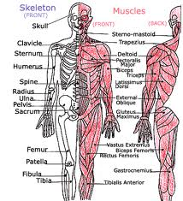
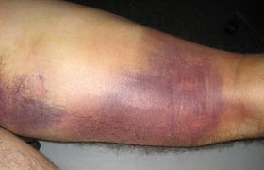
Pressure injury against bone
Muscle injury pull-tear
http://running.competitor.com/2012/04/injuries/expert-advice-did-i-pull-or-tear-a-muscle_38878
In time can lead to an open wound.
Inside outward or outside in.
Can result in further muscle/tissue damage

Slide 3
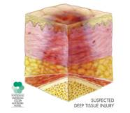
Possible Deep Tissue Injury
A deep tissue injury is more than the acute damaged tissue under intact skin; it looks like a deep bruise.
A suspected deep tissue injury needs to be examined by a physician or wound specialist as it can quickly become a Stage III or IV pressure ulcer.
http://www.stoppain.org/pressureulcers/pressure_ulcers.asp

Slide 4
The causes of DTI development are multifactorial / complex series of events
Bone/muscle interface deformation,
Ischemia
Ischemic reperfusion injury
Impaired lymph drainage
Alteration in interstitial fluid flow
Alteration in capillary wall permeability- edema,
Inflammatory changes conducive to apoptosis
Honaker et al., 2012

Slide 5
How to prevent further muscle or tissue damage as a result of the primary injury ?
Prevent skin breakdown
Increase blood flow
Apply heat
Apply cold
Medications ? Anti-inflammatory
(Nonsteroidal anti-inflammatory drugs, NSAIDs--- block prostaglandins production)
(Steroids such as glucocorticoids- reduces swelling)
Current recommendations follow accepted standard of care for treating pressure ulcers. These include repositioning schedules, support surfaces, topical dressing application, and nutritional support.
At this time, there are no new treatment options identified in the literature for DTI.
Honaker et al., 2012
Notes:
Nonsteroidal anti-inflammatory drugs, usually abbreviated to NSAIDs
Most NSAIDs act as nonselective inhibitors of the enzyme cyclooxygenase (COX), inhibiting both the cyclooxygenase-1 (COX-1) and cyclooxygenase-2 (COX-2) isoenzymes. COX catalyzes the formation of prostaglandins and thromboxane from arachidonic acid

Slide 6
Journal article
Effects of non contact low-frequency ultrasound on healing of suspected deep tissue injury: A retrospective analysis
Jeremy S Honaker, Michael R Forston, Emily A Davis, Michelle M Wiesner, Jennifer A Morgan
Central Baptist, Hospital, Lexington, KY
International Wound Journal. 2012 Pre press

Slide 7
To determine if ultrasound therapy would be beneficial or harmful.
Ultrasound therapy:
Deliver ultrasound at a low intensity and a low frequency of 40 kHz.
Non contact low-frequency ultrasound (NLFU)mist.
Non thermal effects for healing.
The low-frequency ultrasound wave penetrates deeper tissues as compared to longer waves.

Slide 8
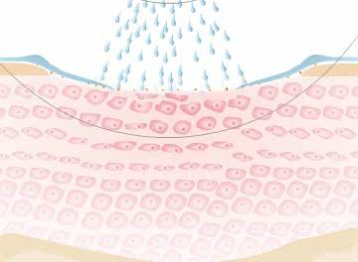
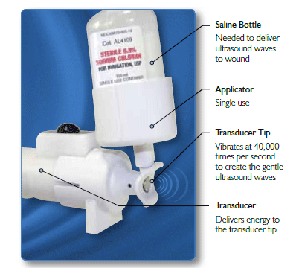
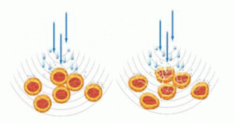

Slide 9
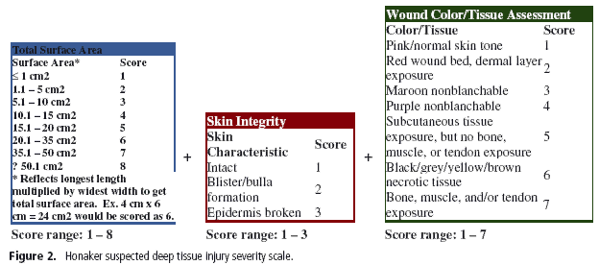
For this study, three characteristics of SDTI were used to identify their severity: TSA, skin integrity and wound colour/tissue assessment.

Slide 10
Take home points:
The total difference noted between the two groups accumulated showed
a significant decrease in wound severity (2·52 on the 3–18 point severity scale) between the NLFU and control group for the discharge assessment .
The findings of this study suggest that NLFU may have a beneficial effect on the progression of SDTI. This is an initial attempt to validate the use of NLFU as an affective treatment for SDTI.

Slide 11
Mechanisms ?
Low-frequency ultrasound has been shown to upregulate endothelial nitric oxide synthase (NOS) secondary to the shear stress induced by cavitation and microstreaming (Suchkova et al., 2002)
The upregulation of endothelial NOS :
Improving blood flow
Decreased muscular reperfusion edema
Blunted inflammatory response by decreasing leukocyte extravasation
Free radical-induced leukocyte chemotaxis
Decreased nitrogen- and oxygen derived free radical formation
Upregulation of vascular endothelial growth factor
Decrease in the release of TNF-alpha and interleukin 1 (decrease cytokines)
Suchkova VN, Baggs RB, Sahni SK, Francis CW. Ultrasound improves tissue perfusion in
ischemic tissue through a nitric oxide dependent mechanism. Thromb Haemost 2002;88:865–870.
Huk I, et al. L-arginine treatment alters the kinetics of nitric oxide and superoxide release and reduces
ischemia/reperfusion injury in skeletal muscle. Circulation 1997;96:667–675.
Ozaki et al. Overexpression of endothelial nitric oxide synthase in endothelial cells is protective against ischemia-reperfusion injury in mouse skeletal muscle. Am J Pathol 2002;160:1335–1344.

Slide 12
What next ?
“However, the currently available literature does suggest that low-frequency ultrasound is capable of stimulating cellular activity through mechanical energy in the absence of key growth factors, ATP, cytokines or other enzymes.” (Honaker et al., 2012).

Slide 13
I feel experimental studies in animals are
warranted to measure:
Measure blood flow with Doppler.
Glucose uptake.
Tissue perfusion (saline).
Monitor if K⁺ spillage present in injury site.
If K⁺ is high, test effect of K⁺ injections and muscle damage (non-human studies).

Slide 14
K⁺ idea
1930’s, experiments were conducted on the toxic effects of K+ to normal cells from damage cells (Feng, 1933).
“Crushed muscle with this concentration of potassium free to diffuse cannot avoid being toxic, in view of the fact that Ringer containing only 10 times the normal concentration of potassium is already so…..”.
Envision future treatments of blunt trauma or a bad muscle tear/spran to promote perfusion of the region with saline and remove excess K⁺.
Feng, T.P. (1933). Reversible inexcitability of tactile endings in skin injury. Journal of Physiology, 79(1),103–108.
Notes:
Such an effect is referred to as ephaptic transmission and is known to occur with the central nervous system (Baylor & Nicholls, 1969).
Feng, T.P. (1933). Reversible inexcitability of tactile endings in skin injury. Journal of Physiology, 79(1),103–108.

Slide 15
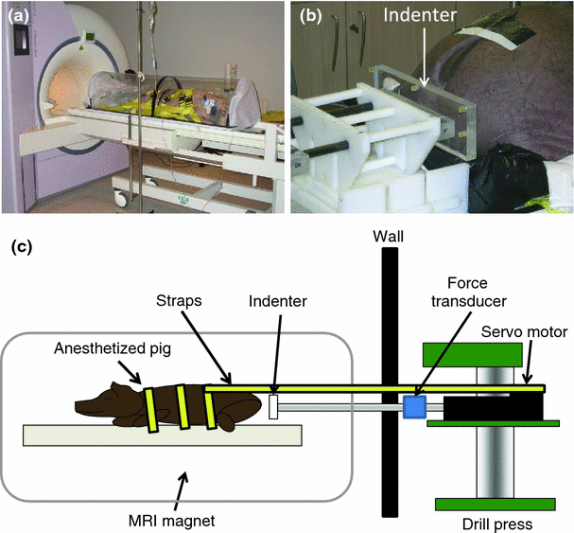
Solis, et al., Distribution of Internal Strains Around Bony Prominences in Pigs. Annals of Biomedical Engineering (2012), 40:1721-39
Notes:
Distribution of Internal Strains Around Bony Prominences in Pigs

Slide 16
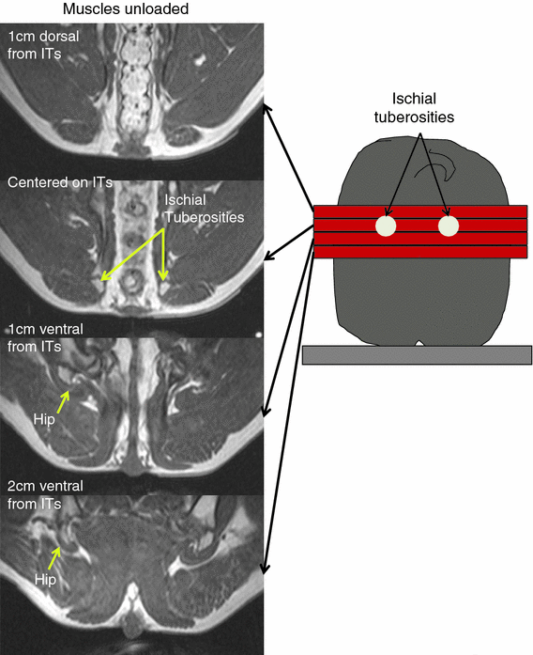
Figure 2 MR images acquired in 4 different slices. (1) 1 cm dorsal from the center of the ischial tuberosities. (2) Aligned with the center of the ischial tuberosities. (3) 1 cm ventral from the center of the ischial tuberosities. (4) 2 cm ventral from the ischial tuberosities

Slide 17
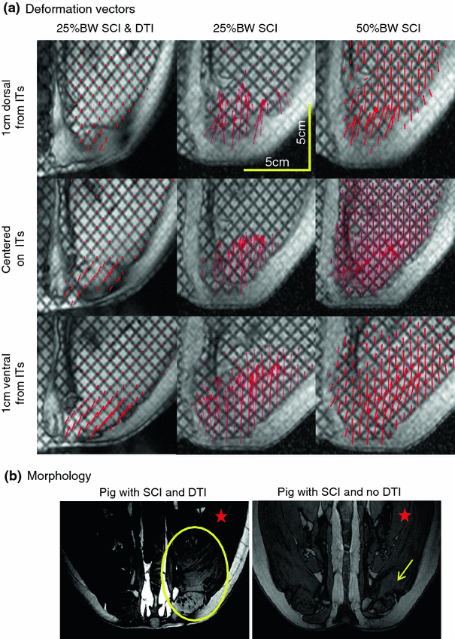
Deformation vectors in pigs with SCI.

Slide 18
Take home from this study
“The main goal of this pre-clinical study was to quantify the levels of strain in pig muscles externally loaded to levels comparable to those experienced by individuals at risk of developing DTI. Secondary to this goal, we assessed the effectiveness of IES in counteracting muscle compression observed in loaded muscles.”
Given the substantial physical, psychological and economical costs associated with DTIs, interventions for prophylactically preventing their formation are needed.
Electrical stimulation for the prevention of pressure ulcers was first proposed by Levine et al. in 1989.
~ “Collectively, … ….various studies suggest that electrical stimulation could be effective in preventing DTI formation. Our approach to the use of electrical stimulation to prevent DTI differs from previous studies in the manner in which electrical stimulation is applied. The pattern of IES is intended to mimic the subconscious postural adjustments (“fidgeting”) performed by able-bodied individuals in response to discomfort while sitting or lying down. Therefore, muscle contractions are elicited by IES for short durations of time (e.g., 10 s) every few minutes (e.g., 10 min). “

Slide 19
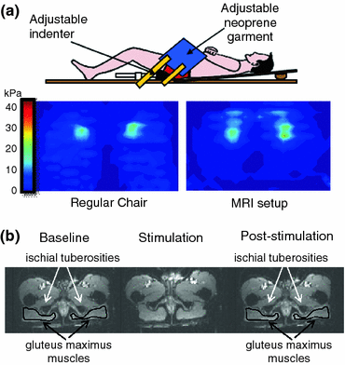
Solis, et al., Effects of intermittent electrical stimulation on superficial pressure, tissue oxygenation, and discomfort levels for the prevention of deep tissue injury. Ann Biomed Eng. (2012) 39(2):649-63.
Notes:
Figure 1 Reproduction of sitting pressure inside the MRI magnet. (a) Top: Setup utilized to load the ischial tuberosities inside the MRI magnet. Bottom left: Pressure map of ischial tuberosities of a volunteer sitting in a regular chair. Bottom right: Pressure map of ischial tuberosities of the same volunteer “sitting” in the MRI setup. Color bar denotes pressure magnitude. (b) MRI images of gluteus maximus muscles from one volunteer during baseline, stimulation, and post-stimulation periods

Slide 20
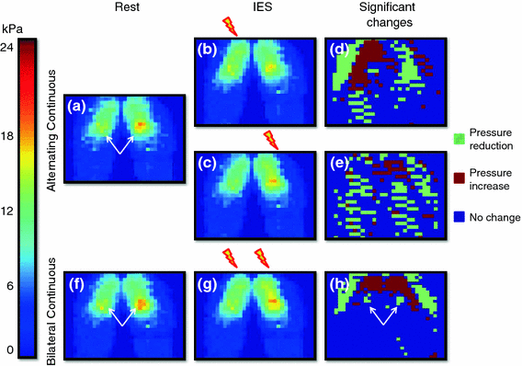
Significant change in pressure during contraction
Notes:
Figure 2 Pressure measurements during alternating continuous and bilateral continuous IES protocols in one volunteer. Baseline pressure map obtained by averaging the sensor values over a 5 s period prior to IES delivery (a). Average pressure maps during alternating continuous IES that produced a contraction in the right (b) and left (c) gluteus. Distribution of sensors that experienced a significant change in pressure (reduction or increase) during contraction of the right (d) and left (e) gluteus. Baseline pressure map obtained by averaging the sensor values over a 5 s period prior to IES delivery (f). Average pressure map during bilateral continuous IES producing contraction of both left and right gluteus simultaneously (g). Distribution of sensors that measured a significant change in pressure during contraction (h)

Slide 21
Take home from this study
increase in signal intensity reflected the increase in tissue oxygenation throughout the gluteus muscles.
When muscle becomes compressed, inflow and outflow of blood in the compressed tissue is compromised due to the occlusion of capillaries and major blood vessels. This ischemia prevents the exchange of oxygen, nutrients, and metabolic waste required to maintain proper cellular health, leading to cellular damage.
Paradoxically, restoration of blood flow after prolonged periods of ischemia can lead to further injury as a result of reperfusion injury
As muscles exercise, nitric oxide is produced, which can inhibit mitochondrial respiration, reducing the consumption of oxygen by the muscle… leads to a surplus of oxygen that comes into the tissue immediately after the muscle contraction
Because of this, the long-term effect of active contractions should be a lowered oxygen demand, making the muscle more resistant to ischemic injury.
ES also provided relief from discomfort due to prolonged sitting.

Slide 22
In my view:
Try a combination of approaches for DTI:
Ultrasound and electrical
Also assess the K+ spillage idea from damaged tissue and see if washing out the “toxin” of K+ would prevent further damage and promote faster recovery/healing.

